Slide 1
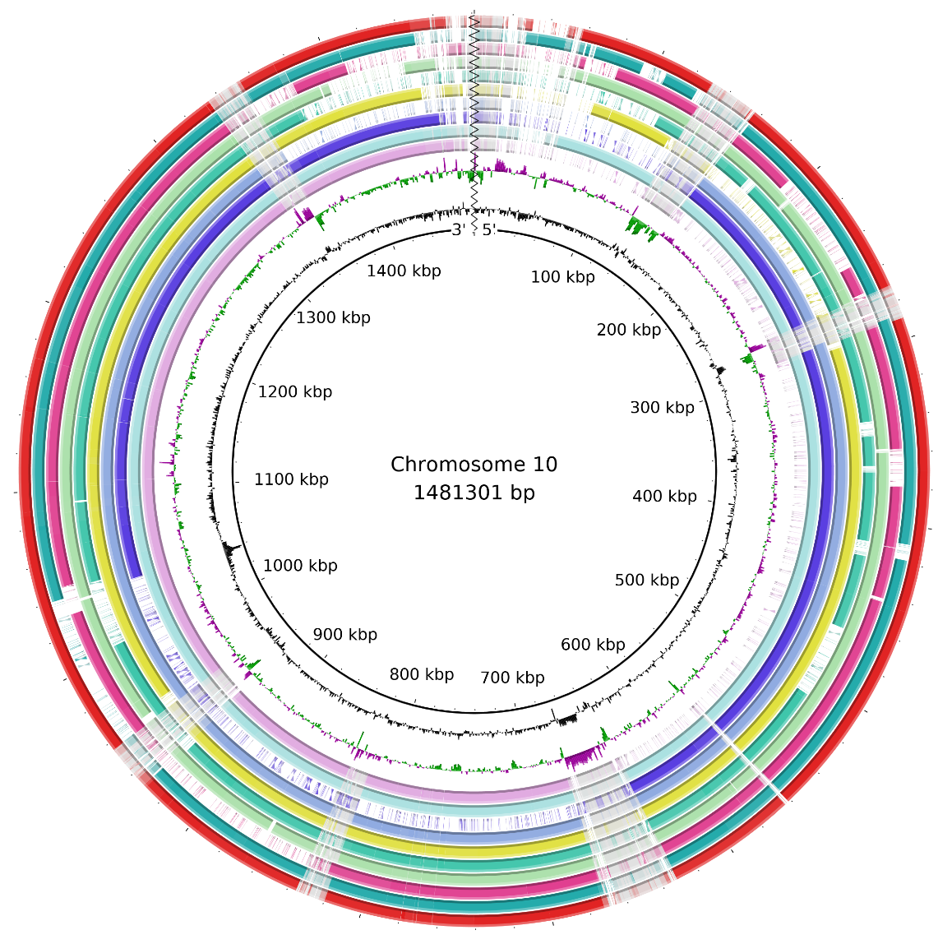
Bioinformatics training
Getting hands on with command line, bioinformatic tools and metagenomic data
Unix Basics

Slide 2

SESSION SET-UP
It’s OK. I’ll wait.
Explore what you can do (within reason)
Ask questions
Feel free to stop me to give more information or context
Hopefully, you have given this a perusal before today
Note: Code to enter will be in purple and comments will be in green
Purple is for you to enter in your terminal and run
Green explains what the purple command does

Slide 3

AIMs:
Beware ye who enter here
Gain access to Gruffalo
Understand the basics of command line Linux environment in the context of biological data
Carry out basic QC filtering and considerations
Align raw reads against a reference genome
Discover the microbial species present in the same
Calculate some basic stats on the generated data
Consider next steps

Slide 4

PLATFORMS:
Which is best? Who knows?
MacOS: All you have all that you need.
Search for “Terminal” on spotlight.
Windows: Many many ways. Recommended is to use MobaXterm!
Download from here: https://mobaxterm.mobatek.net/download.html
Linux: You also have all you need!
Search for “Terminal”

Slide 5
GRUFFALO

Slide 6

HIGH PERFORMANCE COMPUTING
Moh Powah
It is highly time inefficient to carry out bioinformatics analyses on your laptop directly.
The volume of data being generated requires access to a high-capacity, high-performance computing cluster
The cluster we have access to is called ‘Gruffalo’.
More on the cluster: https://www.cropdiversity.ac.uk/#system
Gruffalo has 55 physical nodes, with 1,764 CPU cores and 15,296 GB of RAM.
Gruffalo also has 1.5 petabytes of parallel storage and a further 1 petabyte for backup
Gruffalo is at the John Hutton Institute but it is a collaborative workspace between multiple organisations

Slide 7
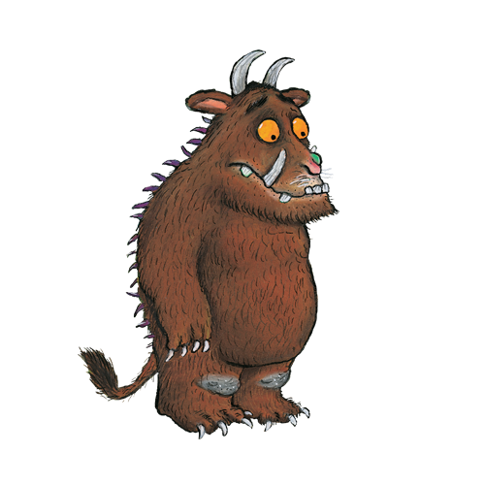
GETTING ACCESS
Open Sesame
On your Terminal or in MobaXterm:
Generate your public and private keys:
“ssh-keygen -t ed25519”
Your public and private keys will be saved in ~/.ssh/id_ed25519 and ~/.ssh/id_ed25519.pub
Find the files on Mac by navigating to: “”.
Email the “id_ed25519.pub” to Iain.Milne@hutton.ac.uk
CC: dro@st-andrews.ac.uk and pjt6@st-andrews.ac.uk
Subject line: “Access to Gruffalo”
Attach the “id_ed25519.pub” to the email for access
If you have any issues with this, let me know
I would recommend giving pages on this page a read: https://help.cropdiversity.ac.uk/slurm-overview.html

Slide 8

FILEZILLA FILE TRANSFER
Open Sesame
Download FileZilla: https://bit.ly/3eAogVV
Open FileZilla; then Edit > Settings
Select “sftp” then “Add key file”
Navigate to your private key that you used to access Gruffalo
You MAY be asked to convert it to a supported format. Select “yes”
Enter a passphrase and save this as a different file name
Go to “Site Manager” then “New site”
Change “ftp” to “sftp” and put “gruffalo.cropdiversity.ac.uk” in the host box
Change logon type to “key file”. Choose the private key file
Fill the user box with the user name you were sent
Click “Connect”

Slide 9
WORKING ON GRUFFALO
Known unknowns abound
Working on Gruffalo will be unlike any other computer you have worked on before
Importantly the first place you log-in to (pwd), does not have a lot of space so you can’t ‘work’ there. It is designed to hold scripts only
You have to work in the ‘scratch’ space (~/scratch/private)
~/scratch/apps also does not have a lot of space. It is designed to hold small software. However, in your case, you will likely not need this at all
Your raw files and final outputs should be saved in ‘~/projects/uosa/Janet_Cox_Singh/’.

Slide 10
WORKING ON GRUFFALO
Is it safe?
Workspace | Path | Function | Backed Up? | Who has access?
HOME | ~ or /home/your_username | Your home directory. To hold scripts and small files | Yes | You but contents can be seen by others
scratch/apps | ~/scratch/apps | To hold tools and software | No | You but contents can be seen by others
Scratch/private | ~/scratch/private | Where you carry out all analyses. Save intermediate files, ongoing projects | No | You
projects | ~/project/uosa/Janet_Cox_Singh | Where you save your raw files and your final outputs from your analyses | Yes | You but contents can be seen by others

Slide 11
WORKING ON GRUFFALO
Its… complicated
When you log into Gruffalo you will find yourself in: `~` which is your HOME directory.
However as I said you cannot work on it. So you will need to change to your scratch space (cd ~/scratch/private)
To carry out any sort of analysis, you will need to ‘request’ the computing power to do so. While you can do small things directly without doing this, it becomes a hassle when there are many other users logged on.
Think of the place you log in as the centre of a spider web. It is the same centre that everyone else logs in also. Too much weight at point will cause the web to break
So you request to move to one of the web branches that spread out from the centre point. This give you more ‘space’ to carry out anything you want to do
Additionally, generally you would use a script and ‘queue’ it on the system to carry out the commands you want
However, we will be working directly on a ‘node’ on the system and entering the commands individually. This makes it somewhat slower BUT it is how you begin learning and also testing the use of a tool

Slide 12
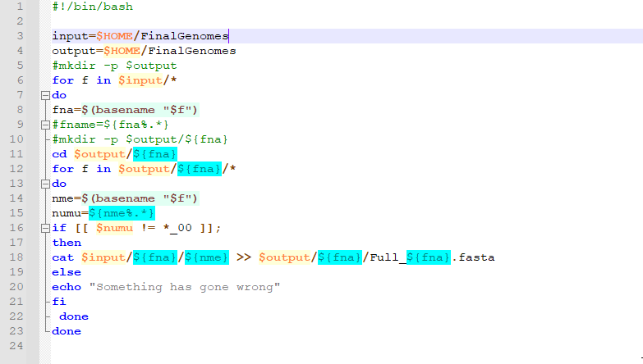
Notes:
Chromosome combined

Slide 13
REQUESTING NODES ON gruffalo
https://help.cropdiversity.ac.uk/slurm-overview.html#interactive-jobs
Put some elbow grease on it
There are two ways to request on Gruffalo.
sbatch – used to submit scripts
e.g. sbatch testing_script_to_do_stuff.sh
However not necessary for this session
srun or srsh – an interactive session. Think of it as logging into a virtual machine on Gruffalo
e.g. srun --partition=short --cpus-per-task=8 --mem=16G
This means you are asking for 8 threads/cores with 16GB of RAM on the ‘short’ partition
So the maximum amount of threads you can use for an analysis is 8 and 16Gb of RAM
Three main partitions:
Short
Medium
Long

Slide 14
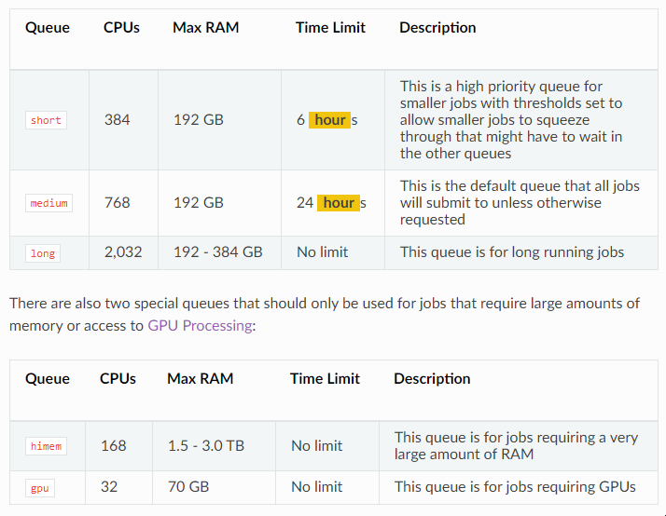
WORKING ON GRUFFALO
Know your queue

Slide 15
COMMAND LINE BASICS

Slide 16

THINGS TO KNOW
The more you know
Purple texts are the commands you type and run
Instructions will be in blue
Comments are in green
Copy-paste is fine, but you’ll learn better by typing
Don’t blindly copy-and-paste what’s written. Think about why each word is there. Ask questions.
Copy-pasting errors into Google is encouraged.
Type carefully!
Case matters. A file named “Case.txt” is different from “case.txt”
Being completely accurate matters
Read the errors!
You will get errors. It is inevitable. They tell you what has gone wrong while also conspicuously not telling you enough to fully understand it. So Google is your friend
Be extremely careful when you delete files or folders. We will come to this later

Slide 17

USEFUL COMMANDS
With these small commands, you can do magic!
Command | Example | What does it do
ls – list | ls -altr or ls -l or ls -a | Lists all files or folders in the current directory you are in
cp – copy | cp <source/file> <destination> cp -r <source/folder> <destination> | Copies a file or folder (-r) from source location to desired destination
mv – move | mv <source/file> <destination> mv <source/file> <destination/newfile/name> | Moves a file or folder to desired locations. Can be used to rename
cd – change directory | <cd path/to/destination> | Change your working directory
pwd – printing working directory | <pwd> | Outputs the path of the directory you are currently within
rm -- delete | <rm path/to/file> | Permanently deletes the indicated file or folder.
man – manual | <man command> | Outputs the manual of an indicated command
Notes:
Ok some terminologies. The first one is directory. This just means folder. I don’t know why they didn’t call them folders but in Linux, directory means folder
Each of these have multiple additional utilities that you can add to extend what they can do however the most important thing that you will need is the “-r” addition to copy, move and remove. –r means recursive so its carries out the desired command for every file and folder within the folder you indicate
Move also works as rename basically. So you can move a file and change the name it is called in the new location

Slide 18
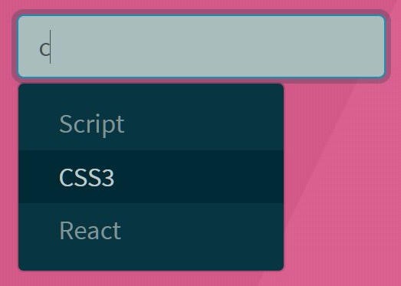
Tab Completion
Finish it!
We type a lot and having to type in filenames over and over again gets repetitive AND you could easily make mistakes!
To solve this, the computing magicians invented tab completion
So start typing the name of a file or folder then press the tab button
This auto-completes the filename or folder that is being typed
It ranks filenames and folders alphabetically.
Fairly straightforward and easy to get.
Remember to tab-complete!

Slide 19
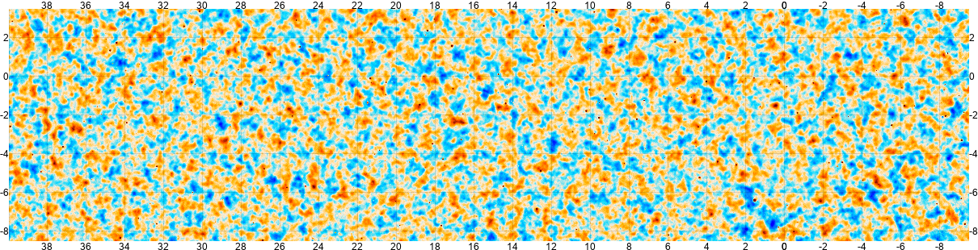
Wild Cards
Be careful.
Name originates from playing with cards
* means anything and any number of them
? means any one character
Change your directory to the ‘list’ directory in the Exercises directory
ls -l a* (shows everything starting with a)
ls -l *.csv (shows all .csv files)
ls -l * (what did this do? Why?)
ls -l ?f.*

Slide 20

PATHS
Not just forks but spoons too
~ is your home folder (/storage/home/users/<username>)
./ is the folder you are currently in
../ is the folder above where you are.
Change folder to the Bioinformatics_Training/Exercises/list folder
cd ~/Bioinformatics_Training/Exercises/list
This is an absolute path that works regardless of where you are
Change folder to the Bioinformatics_Training/Exercises/mv_cp_rm folder
cd ../mv_cp_rm
This is a relative path i.e. it is relative to which folder you are currently in

Slide 21

Changing where you are
Send me your location
pwd : shows your where you are now. e.g. /home/usr/folder2
cd .. : take you up one level e.g. from /home/usr/folder2 to /home/usr
cd - : takes you to your previous folder
cd : take you home. Home is essentially your default folder. Often it is /home/<username>

Slide 22

MOVE
Begin inside ~/Metagenomics_Project/Bioinformatics_Training/Exercises/mv_cp_rm
Annie are you ok?
Move the balls into the boxes.
mv blue.ball BlueBox/ (repeat for all the balls).
Move also renames things. Name the all the rabbits!
mv biggest.rabbit Elvis.rabbit
Remember wildcards? Move all the rabbits!
mv *.rabbit RabbitHutch/ (feel free to rename them all)
Check they’re all snuggled tight (ls RabbitHutch/)
Mv also works for folders. Move the hutch into the garage
mv RabbitHutch/ Garage/
Check them again! (run ls on the RabbitHutch in the Garage)

Slide 23

COPY
Stop copying me
Works the same as mv, mostly.
Copy all the tools into the garage
cp *.tool Shelf/
cp Shelf/ Garage/
Try to copy a folder again but use the recursive flag
cp –r Shelf/ Garage/

Slide 24

REMOVE
The point of no return
rm IS A ONE WAY PROCESS. NO GOING BACK.
Really really think hard about what you’re doing.
We’re done with the tools, lets remove them all
rm *.tool (this will remove ALL THE THINGS ending with .tool. Is this what we want to do? Will we need the spade again?)
Same as cp for folders, needs -r
rm -r Shelf/
This is even more dangerous. Be extra careful.
Worried about it? Use rm -i <files>
Forces you to confirm each deletion.

Slide 25

MAKE THINGS
Phenomenal cosmic powers
Move into the hutch (cd Garage/RabbitHutch/)
mkdir makes a directory
Give the rabbits a bed directory
mkdir bed
Make a folder and also further folders within it
mkdir –p bedroom/bed/sheetcolour
This makes the bedroom folder with the bed folder and then sheetcolour folder within it
Touch: creates empty files – why? No idea
Give the rabbits some straw
touch bed/straw.txt
Not just text files, you can name it whatever

Slide 26

FIND THINGS
Wherefore art thou
There were 4 rabbits. We’ve lost one!
Seriously, I lose files more often than I’d like to admit.
Lets find it.
find ./ -name “*.rabbit”
find ~/Bioinformatics_Training/ -name “*.rabbit”
Can you move it back into the hutch?

Slide 27

WHAT… THINGS
Begin inside ~/Metagenomics_Project/Bioinformatics_Training/Exercises
Lets have a look at you then
Prints the entire contents of a file to the command line
cat randomlyGeneratedStory.txt
Print the top few rows, also try it with -n 1
head randomlyGeneratedStory.txt
Prints the bottom few rows, also try it with -n 1
tail randomlyGeneratedStory.txt
Prints the bottom few rows, also try it with -n 1
less randomlyGeneratedStory.txt
Search with /<word> (try /squash)
Exit with q

Slide 28

SEARCH… THINGS
Give me patternsss
grep: searches based on a desired search term
grep <what you’re searching for> <file>
Searches the file bigListOfGenes.csv for CYP51
grep CYP51 bigListOfGenes.csv
Try: grep cyp51 bigListOfGenes.csv
It’s case sensitive! To resolve this:
grep -i cyp51 bigListOfGenes.csv
-i makes it ignore case
Kill the process with ctrl+c
Note: You can grep everything in a folder using
grep <search term> ./* but this is just everything in the folder.
grep -R <search term> ./* will also search sub-folders.
Note 2: If you need to grep a compressed file, use zgrep

Slide 29
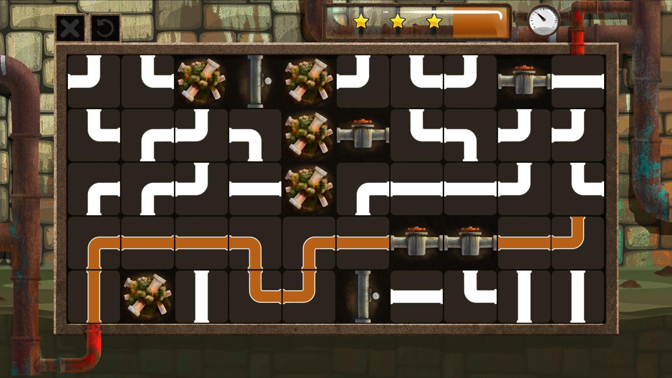
PIPING AND COUNTING
I like it piping hot
Think of pipes as pipes. It allows the transfer of information from one thing to another
Pipes are called with “|”. This is not an L. It is a |. Ask me to show you
So the output of one thing can be transferred to be used as the input for another
wc counts the number of words, but it’ll also count the number of lines with -l
wc -l bigListOfGenes.csv
What if we want to know the number of a specific gene family in the list?
grep -i fox bigListOfGenes.txt | wc -l

Slide 30

saving
Would be a shame if… I just randomly delete you data
> overwrites what’s already in the file
>> adds to the end of the file
Check what’s in the file with cat foxGenes.csv
head -n 1 bigListOfGenes.csv > foxGenes.csv
Check it again
grep -i fox bigListOfGenes.csv >> foxGenes.csv
Then carry out
echo “whoops” > foxGenes.csv
One last check. What happened?

Slide 31

PRACTICAL EXAMPLES
You can do it
Move back to ~/Metagenomics_Project/Exercises
Open the bigListOfGenes.csv
less bigListOfGenes.csv
Are there any entries with NA on them?
/NA searches the file for any “NA”s.
/ repeats the search and moves to the next item.
Have a look at the lines that have NA in them.
Is there anything odd/unexpected in them?
Notes:
Have a look at the lines that have NA in them.
grep NA bigListOfGenes.csv
How many?
grep NA bigListOfGenes.csv | wc -l

Slide 32

PRACTICAL EXAMPLES
Do it right or don’t do it at all
We want a list of all the genes, without the ones with NA on the padj row (at the end of the line).
Hint: use grep
How do we find this out?
Once you find it, how do we save this…
Hint: >
Suggestions?
Notes:
We want a list of all the genes, without the ones with NA on the padj row (at the end of the line).
grep NA$ bigListOfGenes.csv
grep -v NA$ bigListOfGenes.csv
So now we need to save this…
grep -v NA$ bigListOfGenes.csv > bigListOfGenes_removedNA.csv

Slide 33

COMPRESSED FILES
Honey I shrunk the kids
There are many ways to archive and compress things
.gzip, .bzip2, .zip
Uncompressing these:
tar -xvf <file> for .tar files (also works on .tar.gz)
gunzip <file> for .gz files
bunzip2 <file> for bz2 files
unzip <file> for .zip files
See what is inside zipped files (NOT folders)
Print it all: zcat compressedFiles.tar.gz
Print the first 5 lines: zcat compressedFiles.tar.gz | head –n 5
Count the lines of the file: zcat compressedFiles.tar.gz | wc -l
Scroll through the file: zcat compressedFiles.tar.gz | more
Count the number of the desired search pattern: zcat compressedFiles.tar.gz | grep –c “<search_pattern>”
Try this and look into the resulting file:
tar -xvf compressedFiles.tar.gz

Slide 34

OTHER USEFUL TIPS
Be careful.
history : prints out a history of all the commands you previously used
Up/Down arrows : Scrolls through recently used commands
screen : creates a detachable “screen” that you can disconnect from while a command still continues on the detached screen
cat can also be used to merge files together
cd ~/Bioinformatics_Training/Exercises/cat
less aGene.fasta
cat *.fasta > all.fasta
less all.fasta
Windows and Linux have different line endings. New Macs (at least from 2015) should be fine
So if you are working from Windows you may need to use dos2unix to make sure file created on Windows are converted to be Linux compatible
Linux does not like spaces. Use underscores

Slide 35

WHAT WE HAVE COVERED SO FAR
Honey I shrunk the kids
Where am I?
pwd
ls
cd
mv
cp
rm
mkdir
What’s there?
less
cat
head, tail
grep
zipped files
pipes ( | )
redirects (> and >>)

Slide 36

What else may you want to do
Honey I shrunk the kids
Loops – for, while and if
Scripts
Search and replace – sed, cut
Install tools – we will touch on this later

Slide 37
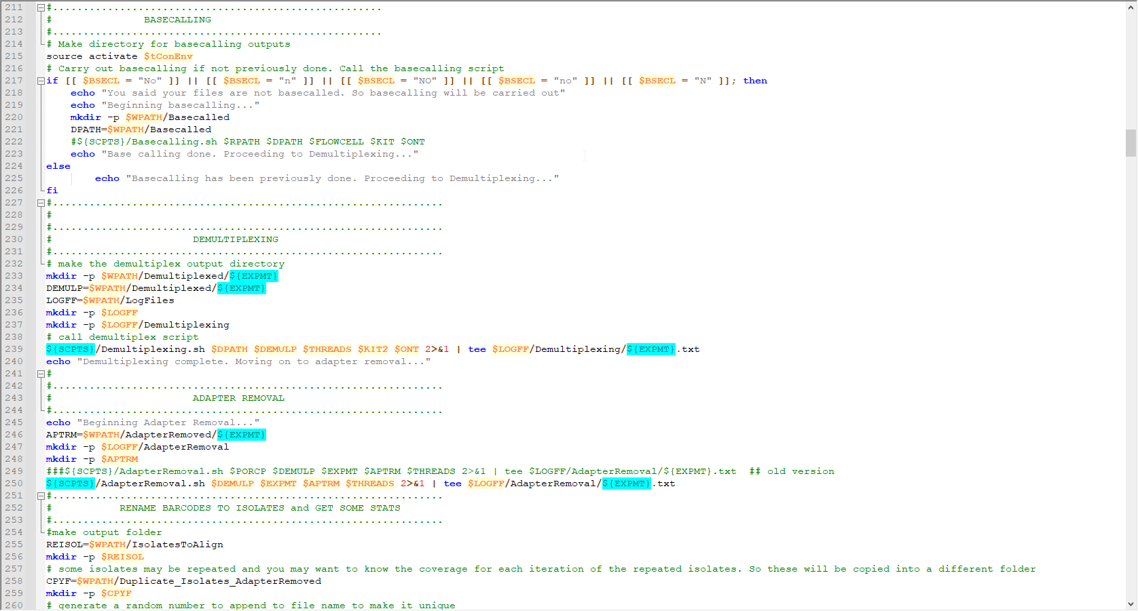
CAN YOU UNDERSTAND SOME OF THESE COMMANDS NOW?

